Slide 1
ReactJS
By Prateek Magarde
https://egghead.io/lessons/react-write-hello-world-with-raw-react-apis

Slide 2
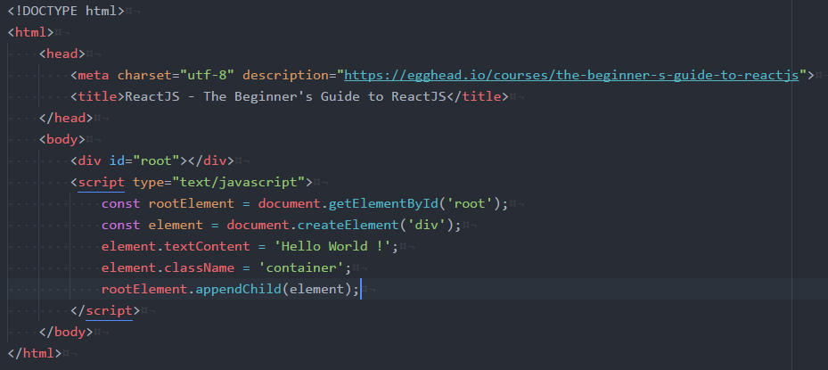
Introduction
In a normal way if we want to show Hello World on the page.

Slide 3
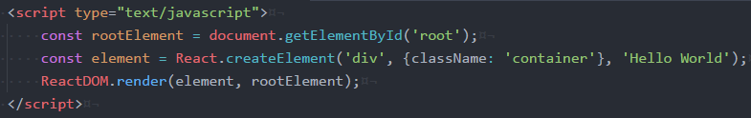
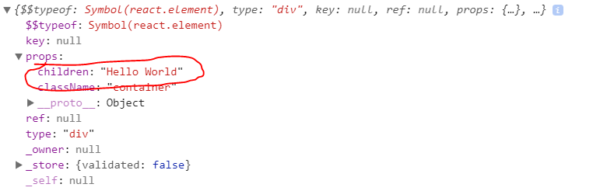
React using online libraries and React.createElement
In React – Using online library:-
We are going to use two libraries
https://unpkg.com/react@16.0.0-rc.3/umd/react.development.js
https://unpkg.com/react-dom@16.0.0-rc.3/umd/react-dom.development.js
If you are looking the element in console then the props will have a children element

Slide 4
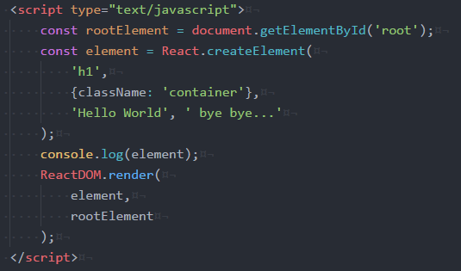

React using online libraries and React.createElement
So, if I am defining two different text content
The output will be

Slide 5

React using online libraries and React.createElement
So, if I am defining two different text content
In the console props will have two children

Slide 6
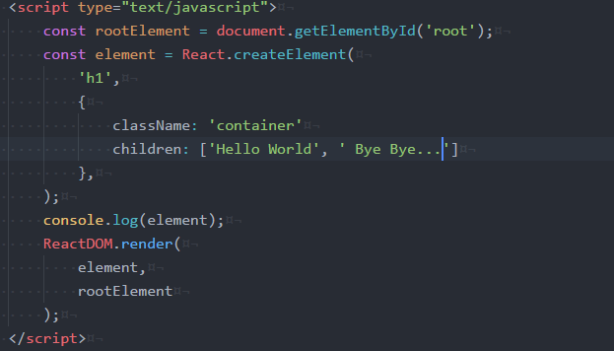
React using online libraries and React.createElement
So, we can directly pass it in props as a children

Slide 7
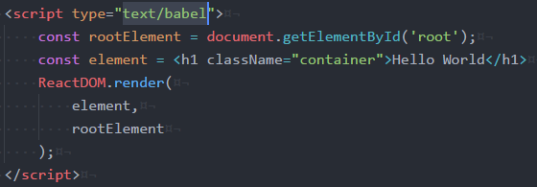
Use JSX with React
- Write createElement is easy but very hectic for bigger content and operations.
- For that we are using JSX.
- If I am directly using html elements it will give me syntax error.
- To get rid of this we are using a transpiler which will convert our html elements into
React.createElement using babel.
And, from text/javascript to text/babel

Slide 8
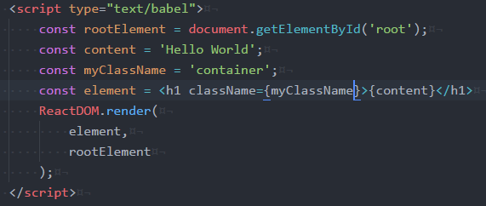
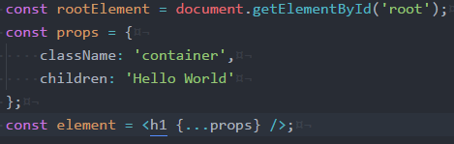
Use JSX with React
You can also keep the content and className in a separate constant and use with {}
I can also use props

Slide 9
Use JSX with React
If we want to override some props like className.
So if the props doesn’t pass the className it will take default class as my-class.
Result className: ‘container’
If I pass the className on other side then
Result className: ‘my-class’

Slide 10

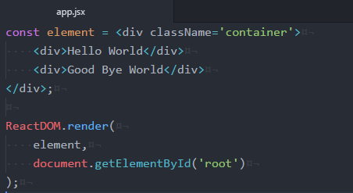
Create Custom React Component
Here we are creating a function which will take props and based on that it will return the
content.
Lets separate the code in app.jsx file.
In this file I am having element with two separate divs.

Slide 11
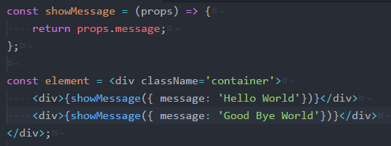
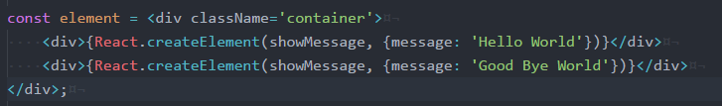
Create Custom React Component
Here we are creating component showMessage and we are using it for showing different
Messages
- We can also pass this in React.createElement as first parameter as the function and second as
the props to this function

Slide 12
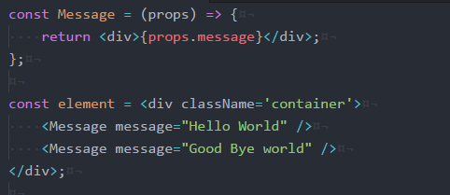
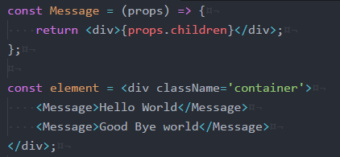
Create Custom React Component
To make this as a separate component.
I can also write it using children props

Slide 13
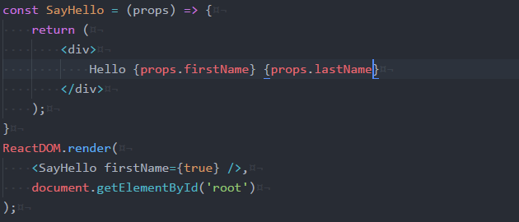
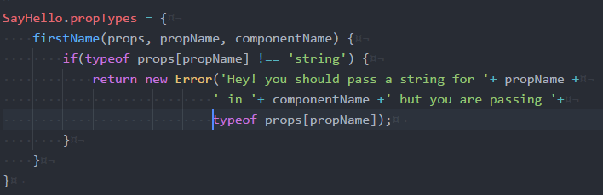
Validate Custom React Component Props with PropTypes
Sometimes people make mistakes on passing props or prop types.
In this case firstName is expecting a string but it’s a boolean. For this we are using SayHello.propTypes.

Slide 14
Validate Custom React Component Props with PropTypes
Sometimes people make mistakes on passing props or prop types.
In this case firstName is expecting a string but it’s a boolean. For this we are using SayHello.propTypes.

Slide 15
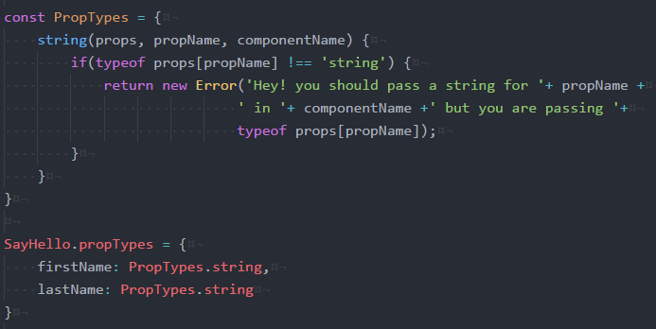
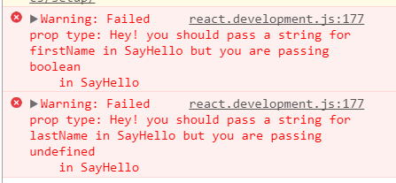
Validate Custom React Component Props with PropTypes
For lastName we can pull the function out. PropTypes.string

Slide 16
Validate Custom React Component Props with PropTypes
For this React team build a library of propTypes.
So we can remove this one.
X

Slide 17
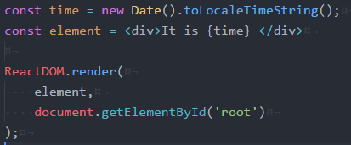
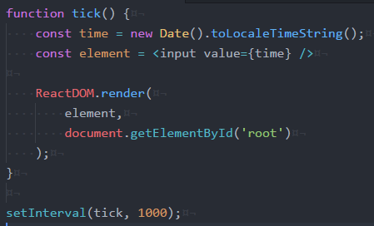
Virtual DOM in React Application
Lets say we have a simple application which is showing current time.
But only for page reload

Slide 18
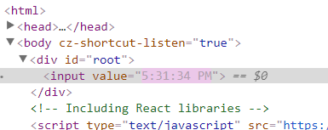
Virtual DOM in React Application
Its updating only that specific element

Slide 19

Style React Components
Property is in camel case

Slide 20
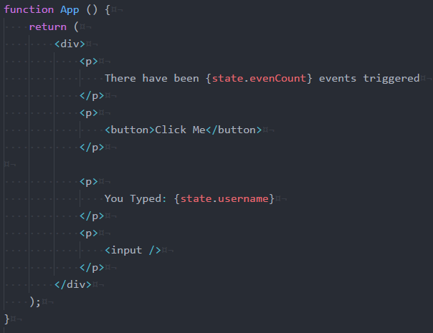
Use Event Handlers with React
Lets say we have a function App which will render some UI

Slide 21
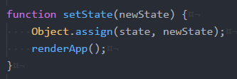
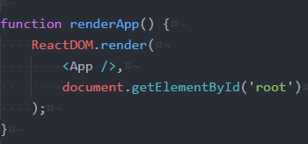
Use Event Handlers with React
We have a function setState which will update the state and call the renderApp function.
Then will have a renderApp function which will render the react DOM

Slide 22


Use Event Handlers with React
For the button I am having onClick function in which will increment the eventCount by 1.
Just keeping it in a separate function

Slide 23
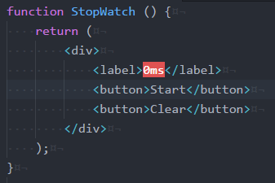
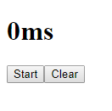
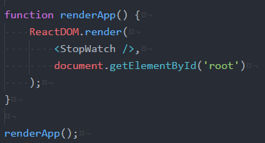
Use Component State with React
Let’s create a function for stopwatch

Slide 24
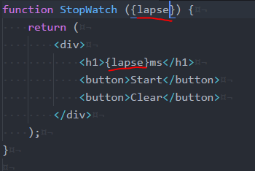
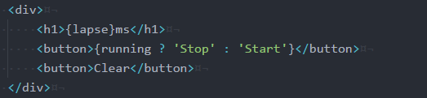
Use Component State with React
Now, will change hard coded value of 0 to a props lapse
Will make Start and Stop text also dynamic

Slide 25
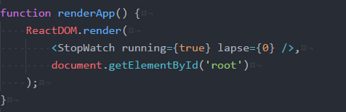
Use Component State with React
Now we are passing those properties from the component

Slide 26
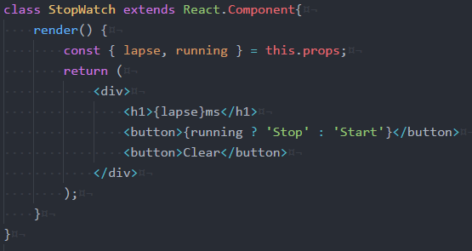
Use Component State with React
Let’s make it in react.
Here we are going to have lapse and running from this.props.

Slide 27
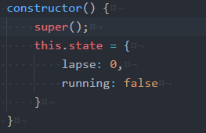
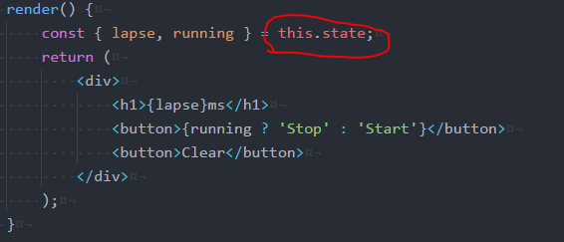
Use Component State with React
Now, in the constructor I am defining states.
And using lapse and running from state

Slide 28
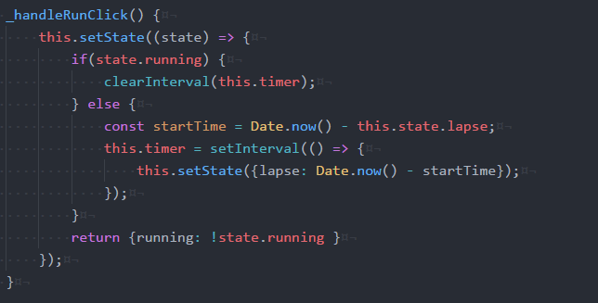
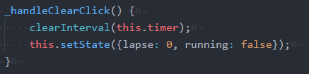
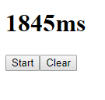
Use Component State with React
For click on start and stop button I am using below function.
To Clear click button

Slide 29

Stop Memory Leaks
There is a memory leak with this method. Our time will still run if we leave the component.
For that we are using componentWillUnmount

Slide 30
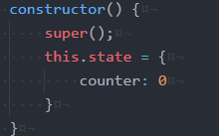
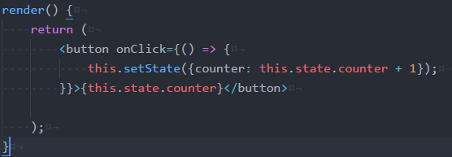
Use Class Components with React
Let’s say, we have a button which will increment our count

Slide 31
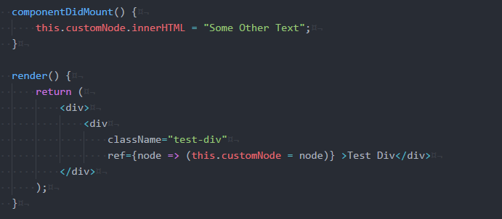
Manipulate DOM with React refs
Ref will be having an arg as node and will access that through out the application.

Slide 32
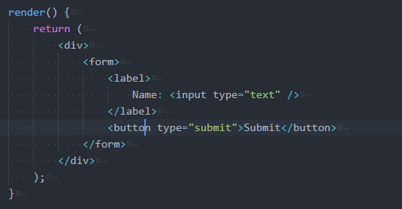
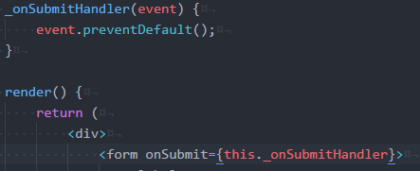
Make Basic Forms with React
Lets say we have a Form with label name and input type text
To Prevent the form submit on Submit click

Slide 33


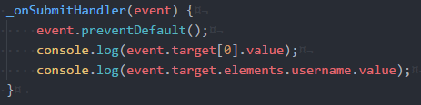

Make Basic Forms with React
We can access values by event.target
By providing name
By ref

Slide 34
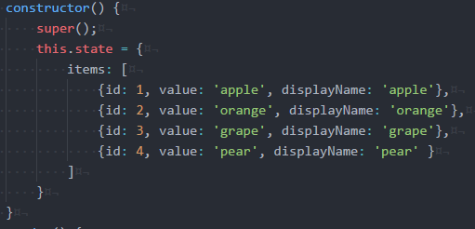
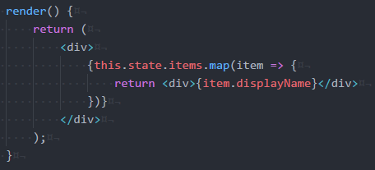
Use the key prop when rendering a List with React
Let say we have all Items
It is showing the warning, because key is not available.

Slide 35
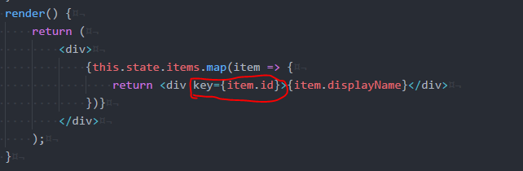
Use the key prop when rendering a List with React
So will provide key to the div

Slide 36
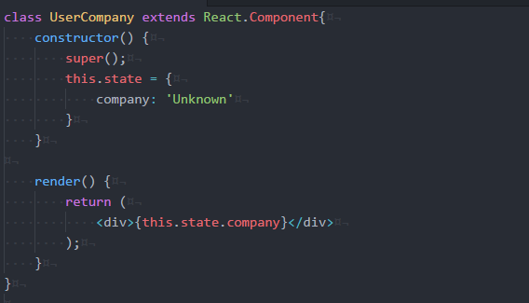
Make HTTP Request by React
Here I am having a UserCompnay component
For HTTP Request we are using axios library

Slide 37
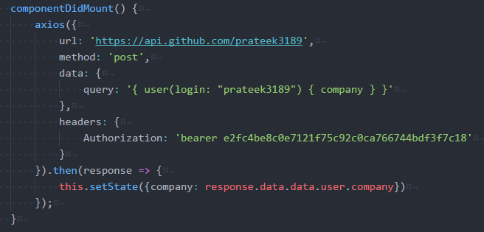
Make HTTP Request by React
We are using Axios

Slide 38

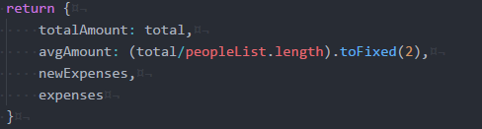
Code Guideline for ES6
Use => functions
Directly use method from object like this.state
Use direct key in object if key and value have same annotation
Online tool
https://codesandbox.io/

